Slide 1
Digital portfolio
STUDENT NAME: SEENURAJ.K
REGISTER NO AND NMID: autunm1455unmcsa18
DEPARTMENT: BSC COMPUTER SCIENCE
COLLEGE: TAGORE ARTS AND SCIENCE COLLEGE/UNIVERSITY OF MADRAS

Slide 2
PROJECT TITLE
DIGITAL PORTFOLIO

Slide 3


AGENDA
Problem Statement
Project Overview
End Users
Tools and Technologies
Portfolio design and Layout
Features and Functionality
Results and Screenshots
Conclusion
Github Link
3/21/2024 Annual Review

Slide 4

PROBLEM STATEMENT
Traditional resumes are static and limited. Students need a digital platform to showcase their skills and projects effectively.
Solution → A personal portfolio website using HTML, CSS, and JavaScript.

Slide 5

PROJECT OVERVIEW
This project is a personal portfolio website built with HTML, CSS, and JavaScript.
It showcases my profile, skills, projects, and contact details in a simple and responsive design.

Slide 6

WHO ARE THE END USERS?
Students – to showcase academic projects.
Recruiters/Employers – to evaluate skills and achievements.
General audience – anyone interested in knowing about me.

Slide 7

TOOLS AND TECHNIQUES
HTML – for structure
CSS – for styling & layout
JavaScript – for interactivity
VS Code – code editor
Browser (Chrome/Edge) – testing and execution

Slide 8
POTFOLIO DESIGN AND LAYOUT
Home – Introduction & photo
About Me – Education & skills
Projects – Work samples
Contact – Email & social links
Responsive – Works on mobile & desktop
8

Slide 9
FEATURES AND FUNCTIONALITY
Responsive design for all devices
Navigation menu for easy access
About, Projects, and Contact sections
JavaScript-based interactivity (e.g., smooth scroll, form validation)
Clean and simple user interface

Slide 10
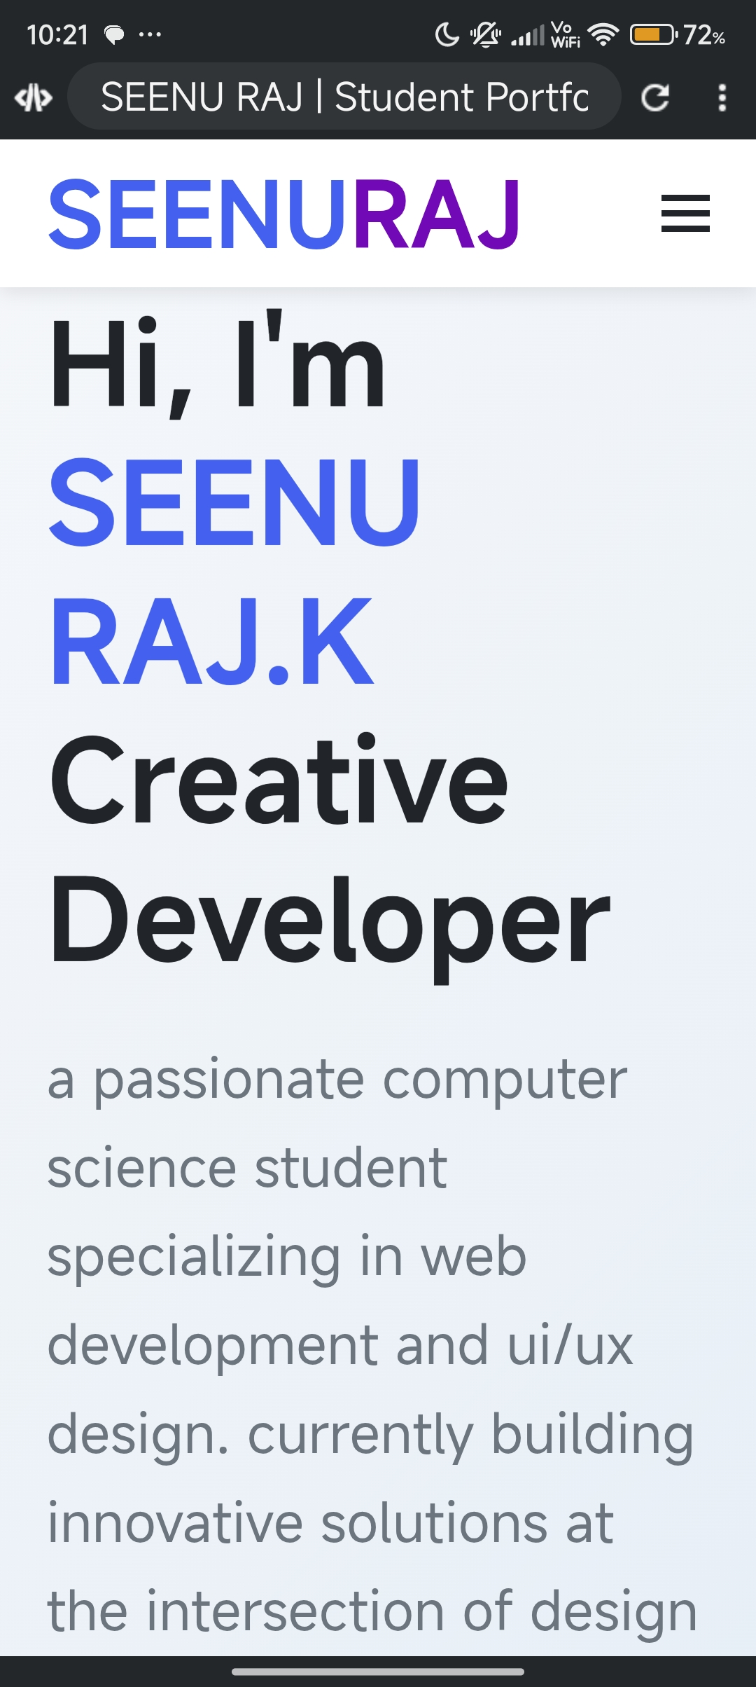
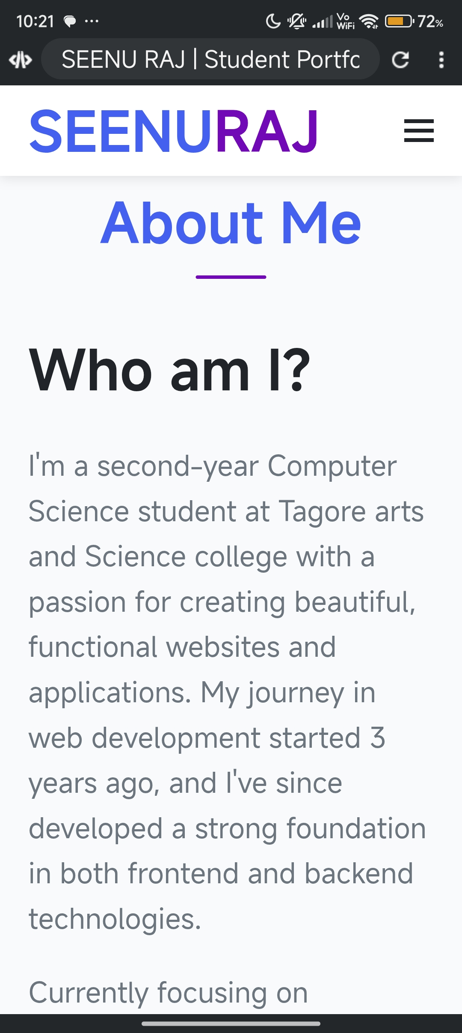

RESULTS AND SCREENSHOTS
3/21/2024 Annual Review
10

Slide 11
CONCLUSION
The portfolio website provides a digital platform to showcase my skills, projects, and achievements.
It is simple, responsive, and interactive, serving as my personal online identity.
11

